Slide 1

(VI) Regression Discontinuity Design (RDD)
GESIS Workshop „Einführung in Methoden der modernen Kausalanalyse“
15.–17. November 2017, GESIS, Köln
Prof. Dr. Michael Gebel
Lehrstuhl für Soziologie, insbesondere Methoden der empirischen Sozialforschung

Slide 2
Outline
The sharp RDD
The fuzzy RDD

Slide 3
(1) The sharp RDD

Slide 4
1. The sharp RDD
Basic idea of sharp RDD:
Find a variable Z that is related to the treatment D in a sharply discontinous way
The selection rule is assumed to be deterministic and known and that all variation in the relevant Z variable is exogenous → assign participants to conditions solely on the basis of quantitative indicators; no judgment, discretion or favoritism
Assignment rule:

Slide 5
1. The sharp RDD
Basic idea of sharp RDD (continued):
We assume that the relationship between Y and Z in the absence of the treatment would be smooth/continuous (=extrapolation assumption)
we can use a regression to estimate the relationship between Y and Z, and if there is a jump at the threshold, we attribute that jump to the treatment.
RDD will capture the causal effects by distinguishing the nonlinear, discontinuous function at the threshold from the linear relationship between Y and Z
Identification of local ATE focuses on comparing individuals around the cut-off value
Assumption that there is no other (omitted) variable that also jumps discontinuously at the same threshold.

Slide 6
1. The sharp RDD
Comparison on sharp RDD and PSM:
No common support/overlap condition: With a certain Z you either belong to the treament or the control group
Difference between PSM and sharp RDD: PSM ensures that we have both control and treatment cases over the range of Z, whereas inRDD there are no values of Z that contain both treated and controls

Slide 7
1. The sharp RDD
Estimation of treatment effect in sharp RDD:
The jump on the vertical axis at the point of the treatment on the horizontal axis is the estimate of the main treatment effect (→ see Figure 1)
More complex treatment effects: The treatment also affects the slope of the relationship between Z and Y, i.e. the size of treatment effect varies with Z
Change in the linear slope (→ see Figure 2)
Change in the functional form (→ see Figure 3)

Slide 8
1. The sharp RDD
Figure 1:
Y
Intercept shift
Z
Z‘

Slide 9
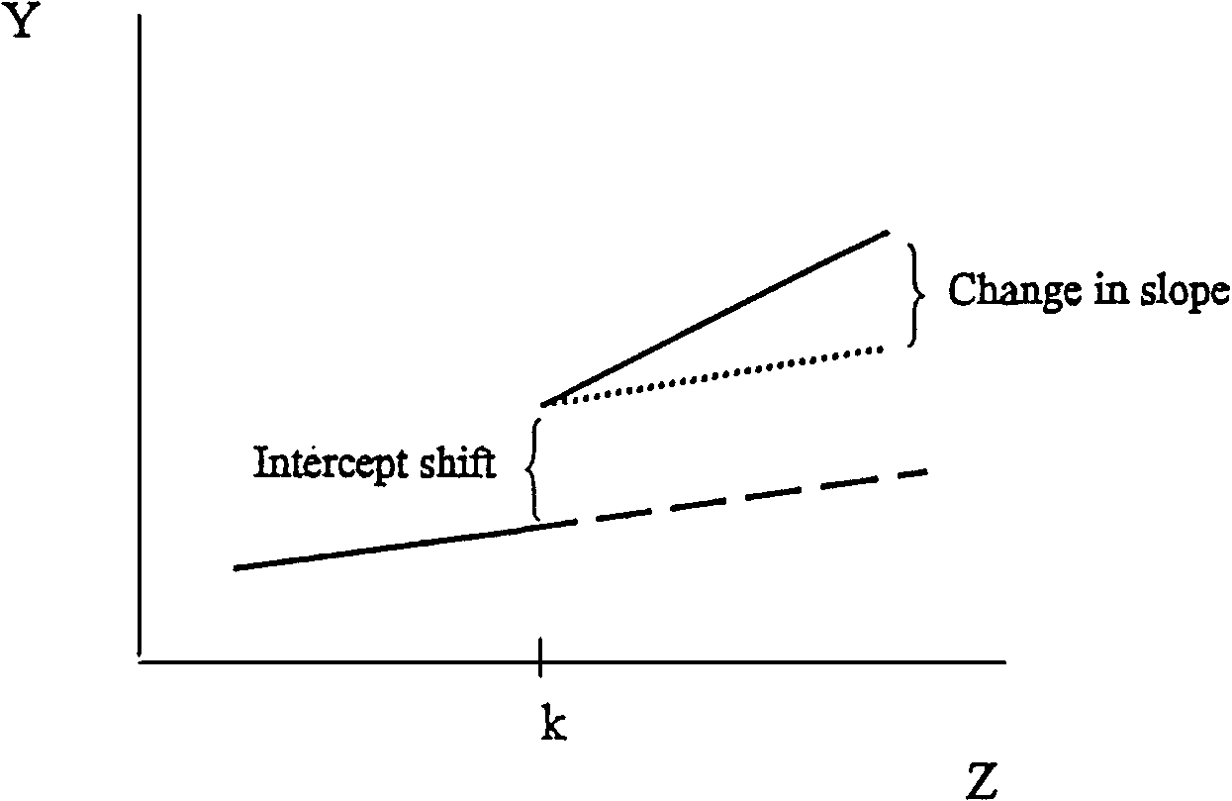
1. The sharp RDD
Figure 2:
Quelle: Winship/Morgan (1999) Figure 1

Slide 10
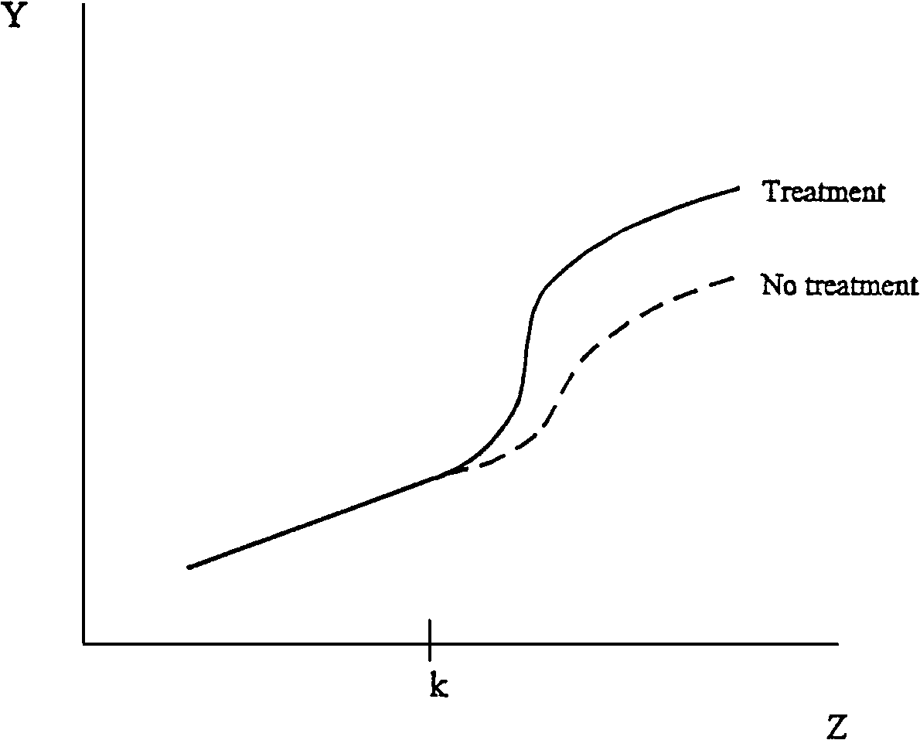
1. The sharp RDD
Figure 3:
Quelle: Winship/Morgan (1999) Figure 2

Slide 11
(2) The fuzzy RDD

Slide 12
2. The fuzzy RDD
Basic idea of sharp RDD:
Fuzzy RD exploits discontinuities in the probability of treatment conditional on a variable Z.
The discontinuity becomes an instrumental variable for treatment status.
Di is no longer deterministically related to crossing a threshold but there is a jump in the probability of treatment at specific value of Z
Assignment rule:

